Slide 1
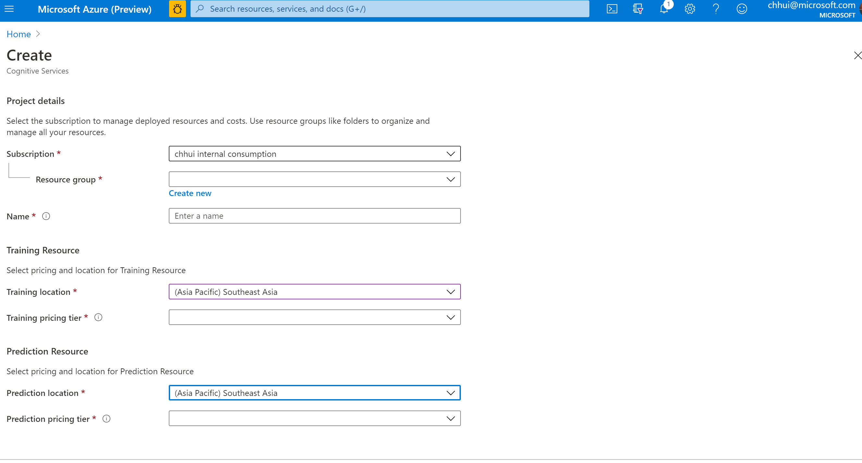
Create Custom Vision resource
Link

Slide 2
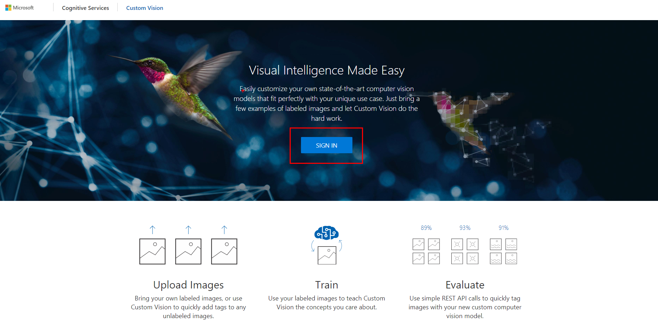
Go to customvision.ai

Slide 3
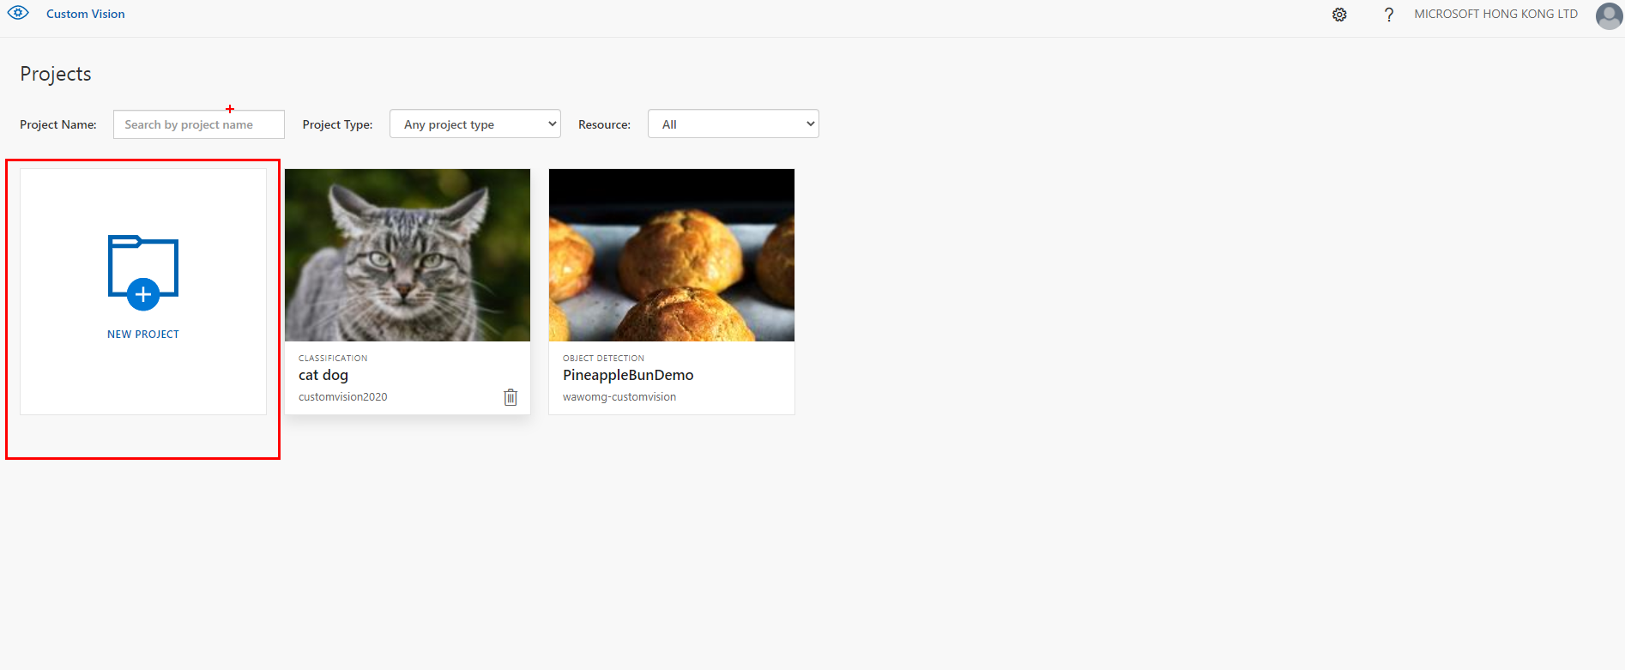
Create new project

Slide 4
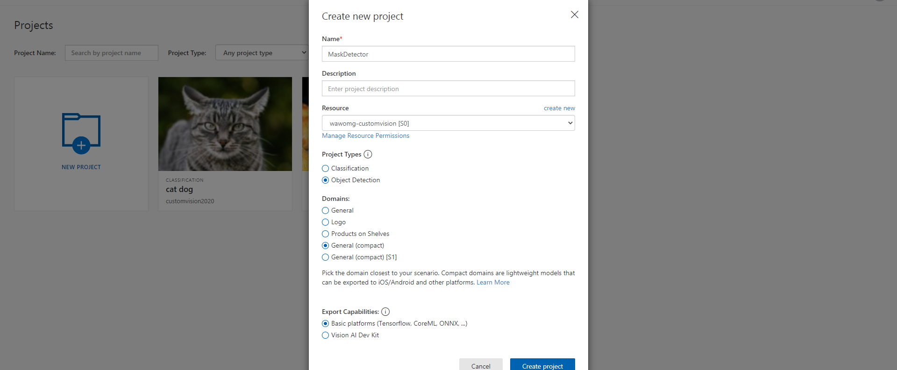

Select same fields as below

Slide 5
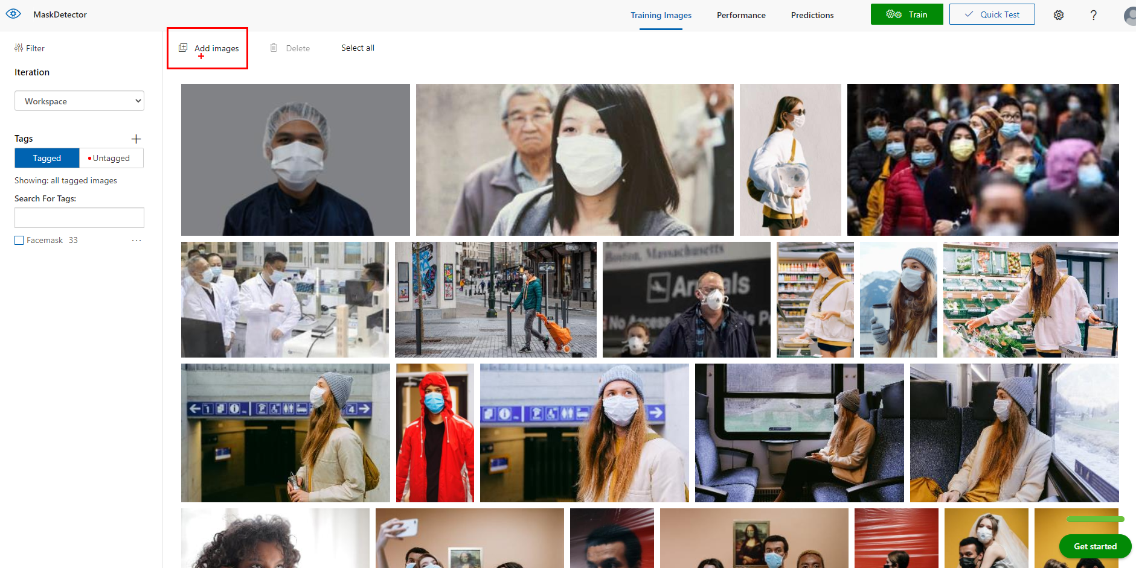

Slide 6
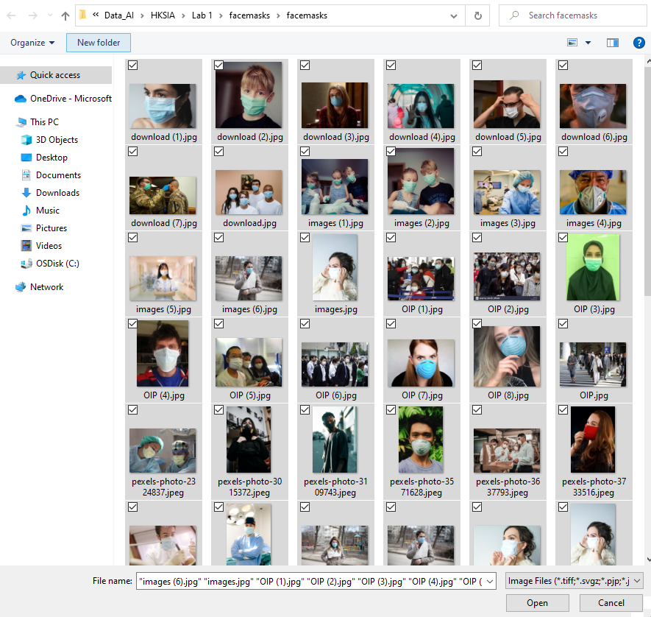
Add all images from the zip file in github

Slide 7

Select one of the images

Slide 8
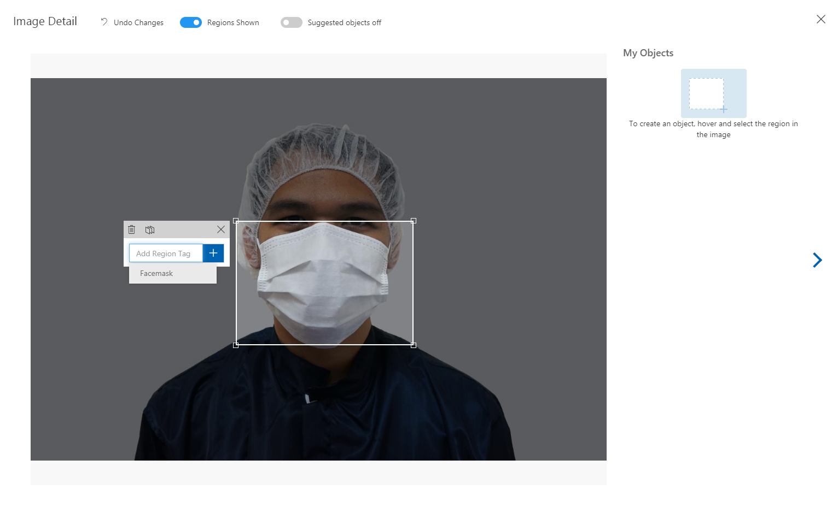
Drag area around the facemask

Slide 9
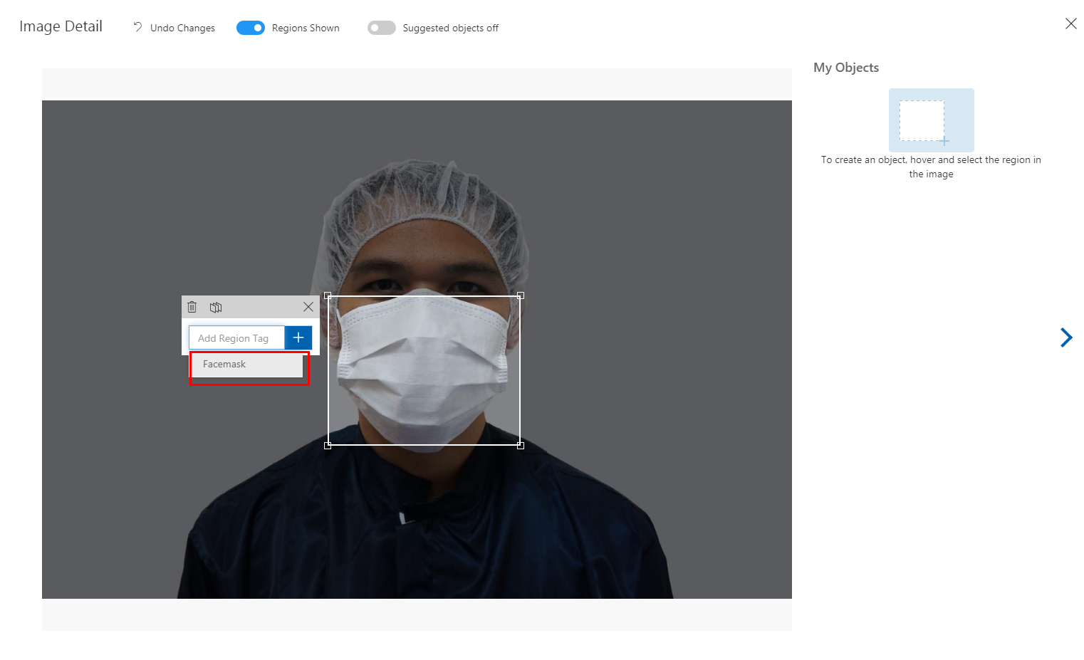
Add a tag named “Facemask”, this will tag the area you selected

Slide 10
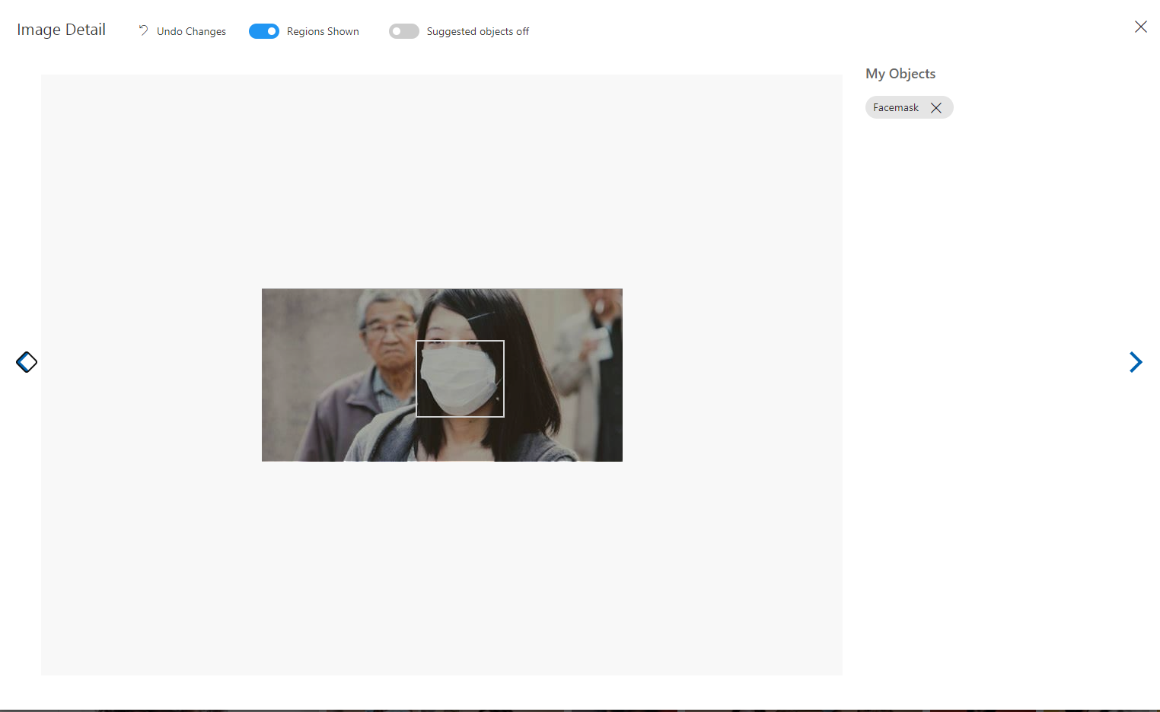
Continue for other images

Slide 11
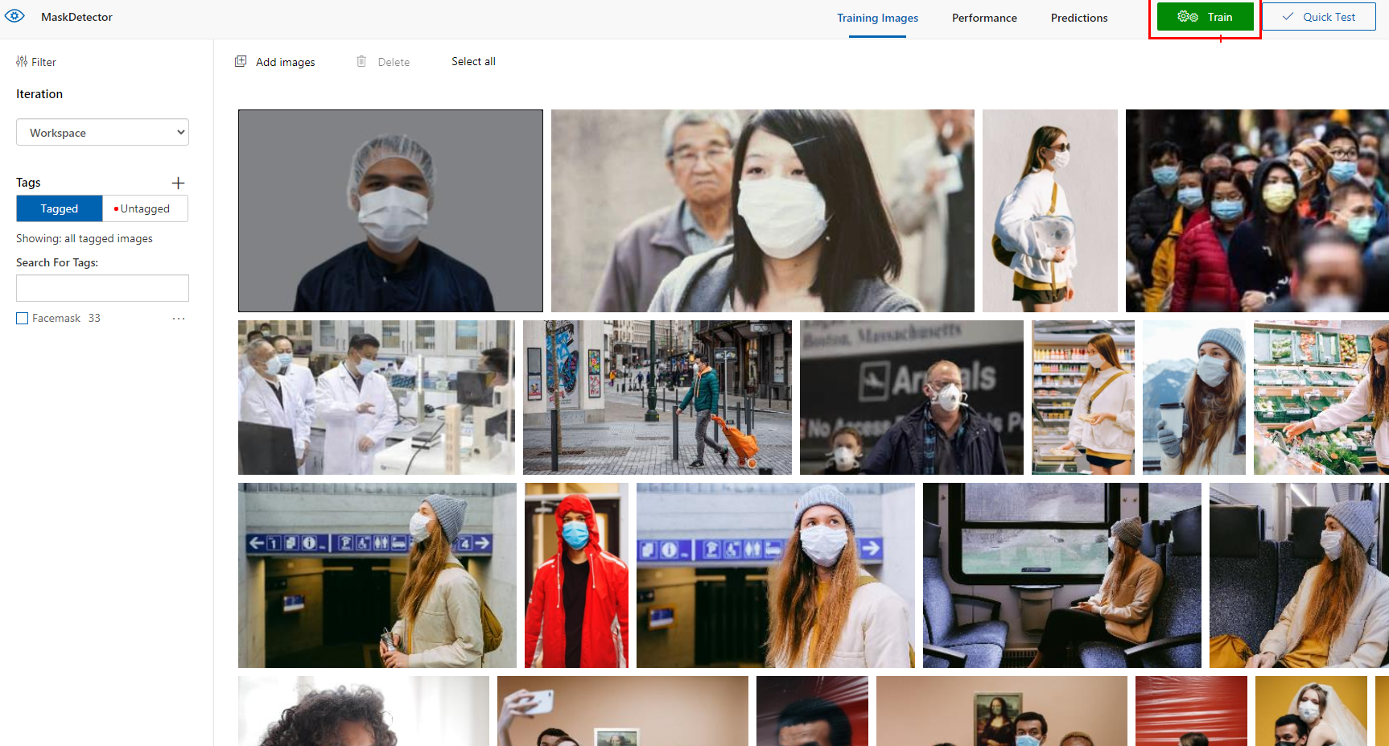
After around 20 images, train the model

Slide 12
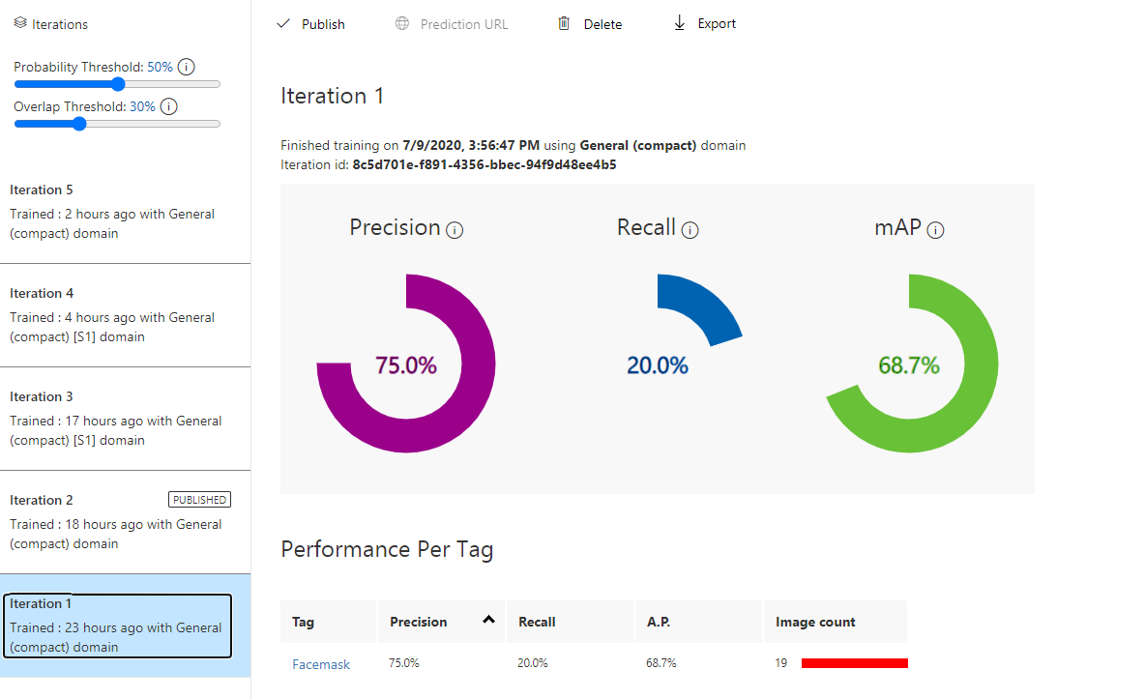
It will show you performance of the iteration

Slide 13
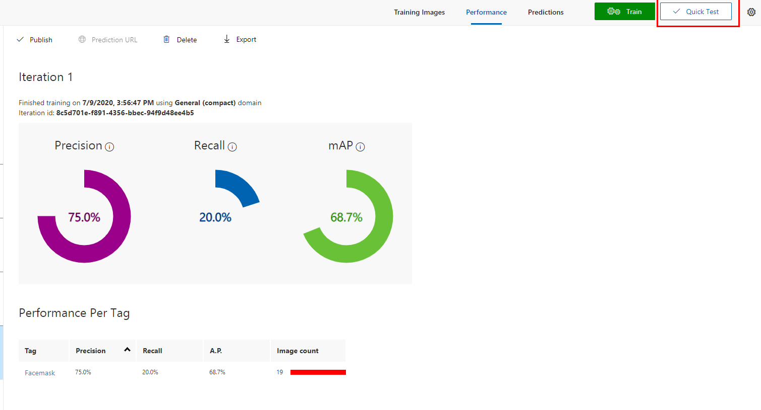
Run quick test using your own images

Slide 14
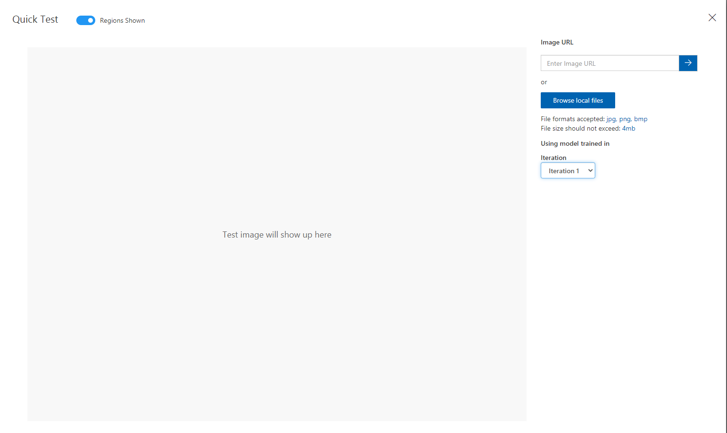

Slide 15
Continue to tag more images
Train model again
See the performance improve
When ready, publish the model

Slide 16
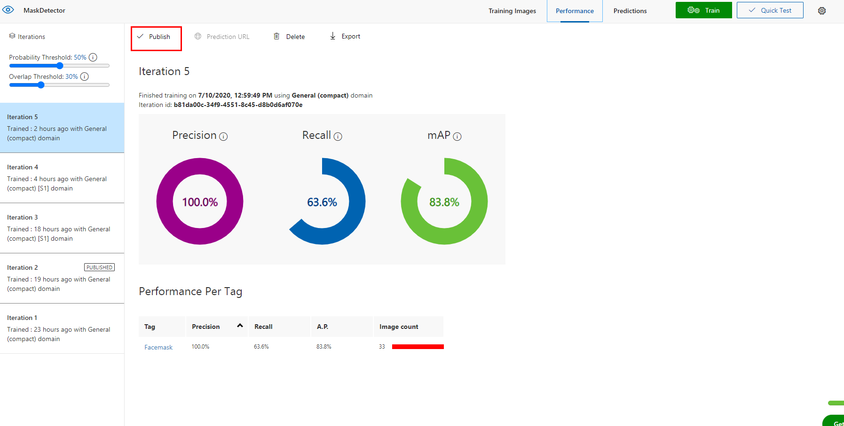

Slide 17
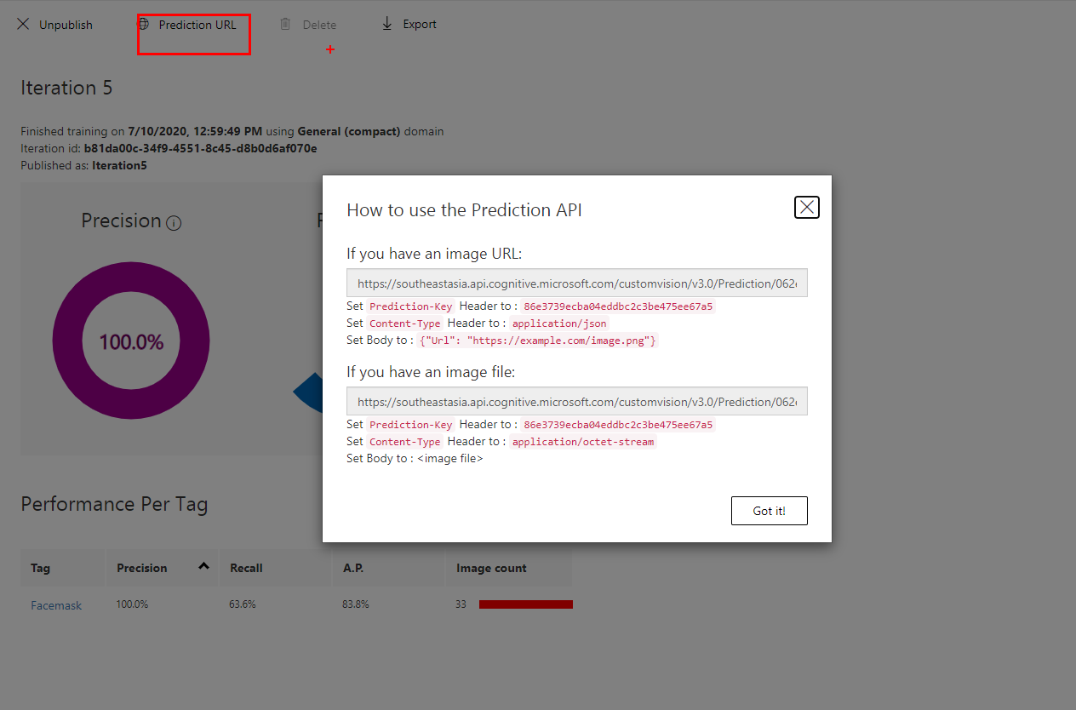
(Optional) Use the Prediction API to predict a image - POST request

Slide 18
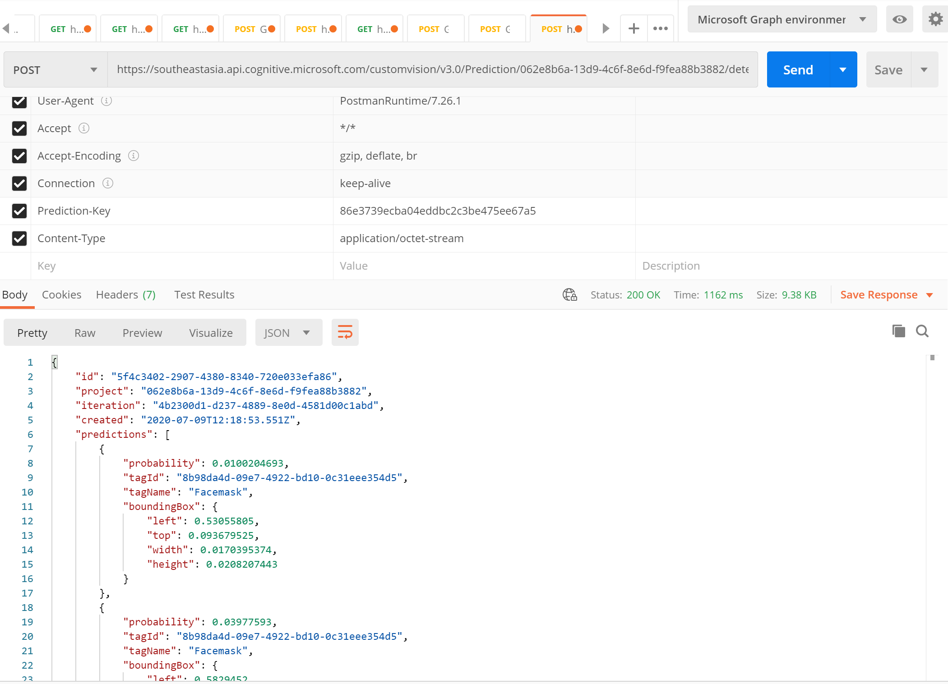
Postman Example

Slide 19
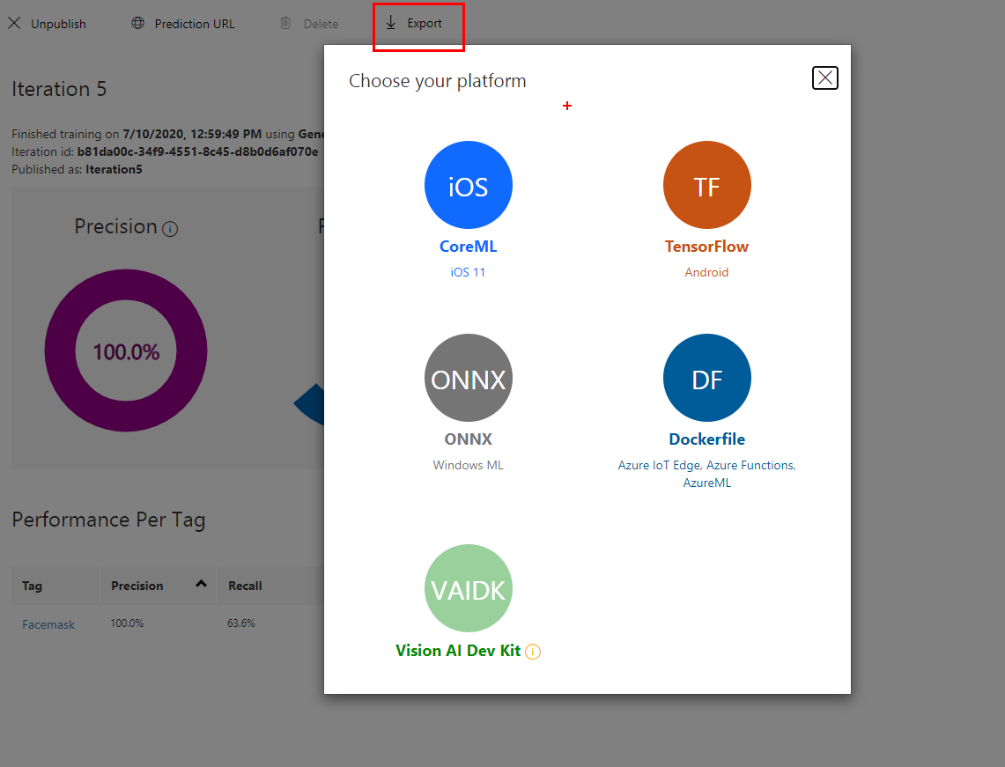
Export model to run locally on different platforms

Slide 20
Advanced

Slide 21
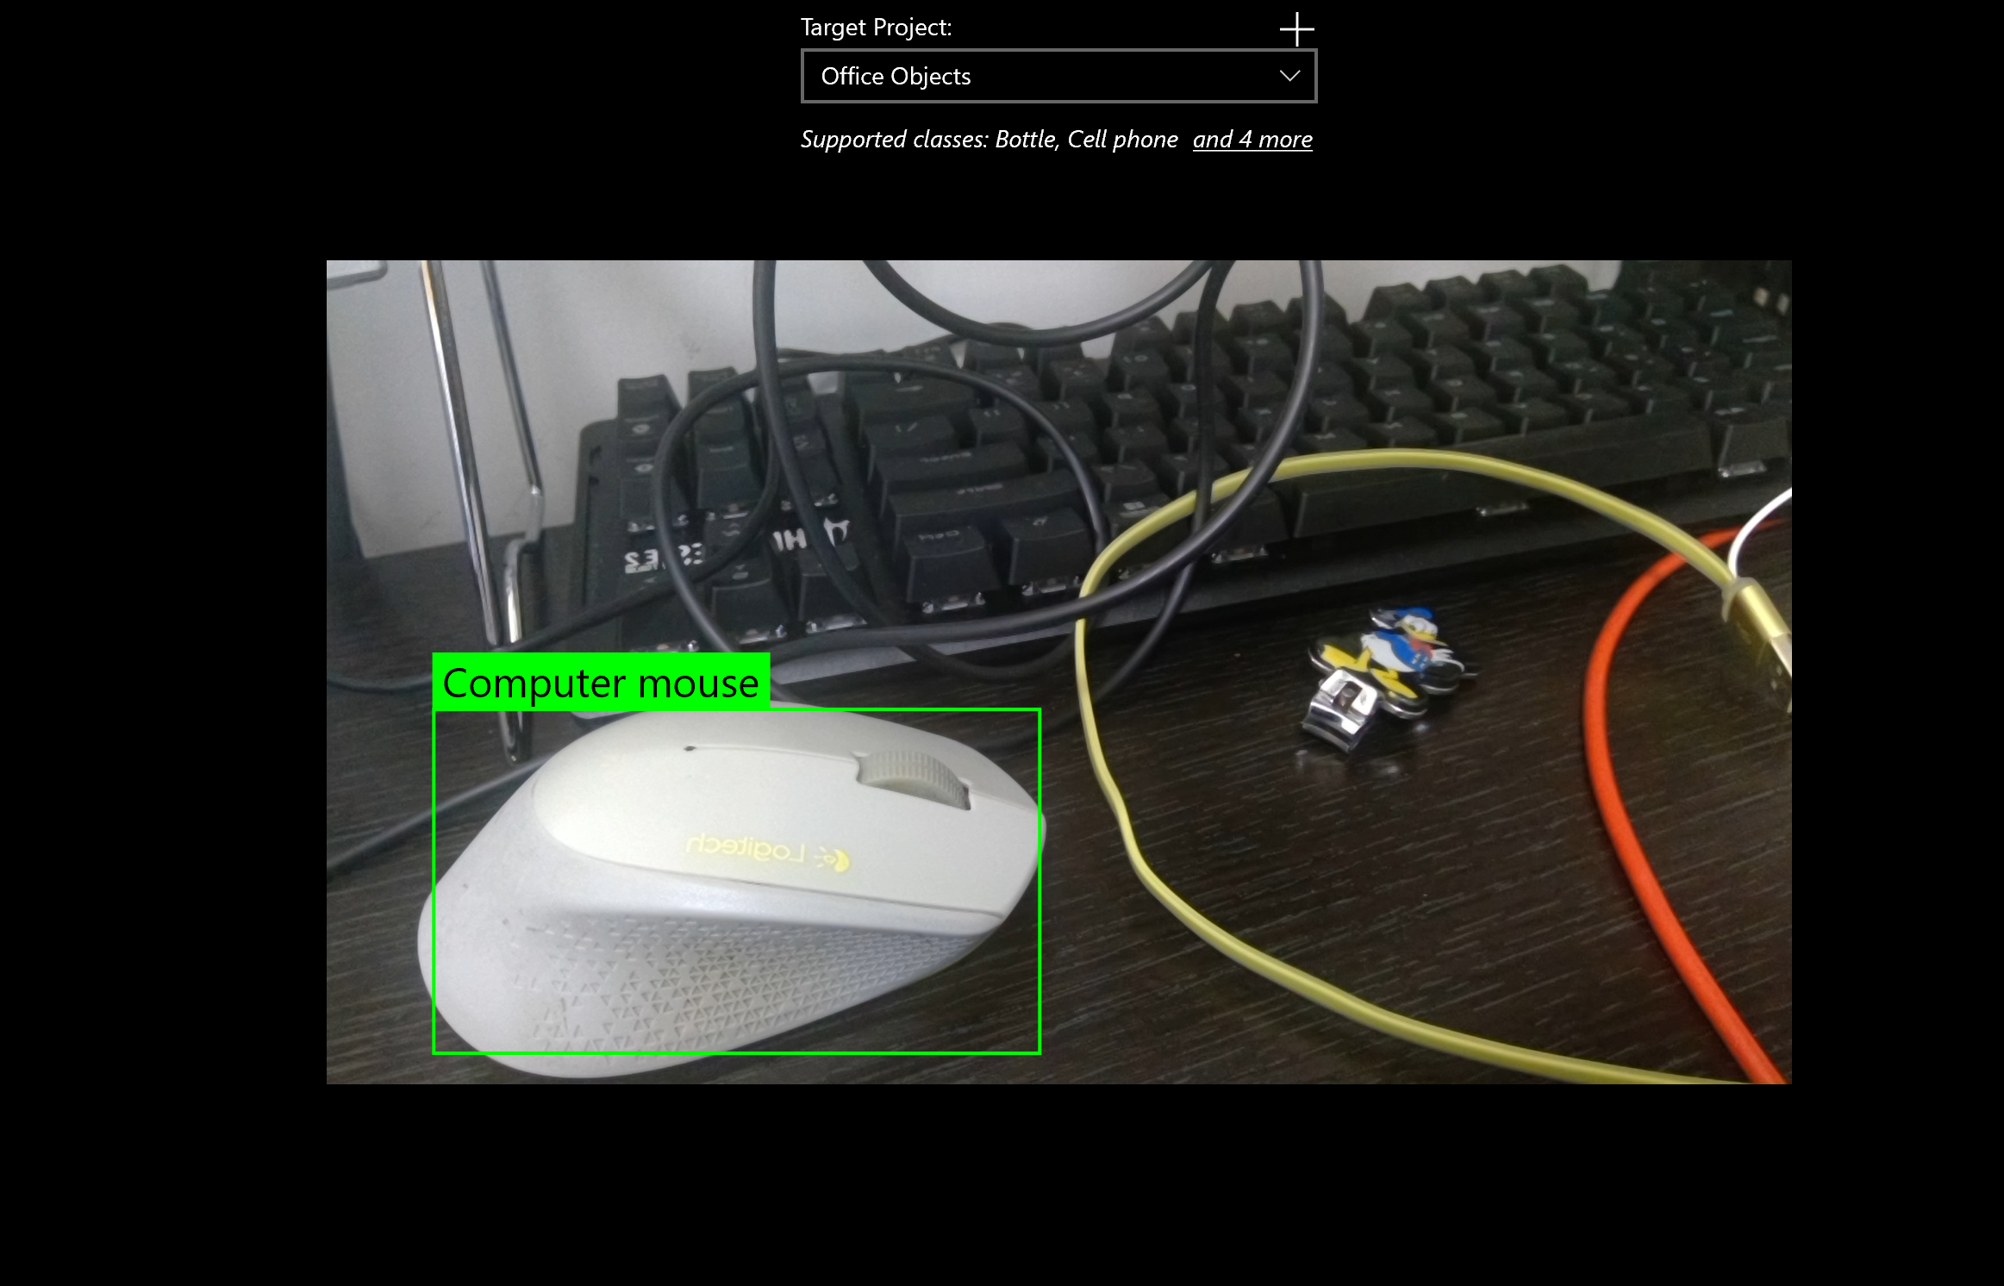
Windows - ONNX
https://github.com/Azure-Samples/cognitive-services-onnx-customvision-sample

Slide 22
Android - Tensorflow
https://github.com/Azure-Samples/cognitive-services-android-customvision-sample/blob/master/object_detection/README.md

